Slide 1
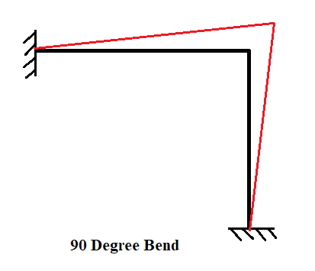
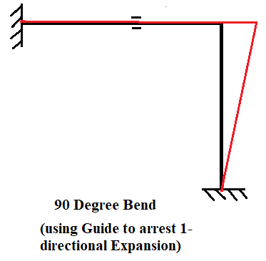
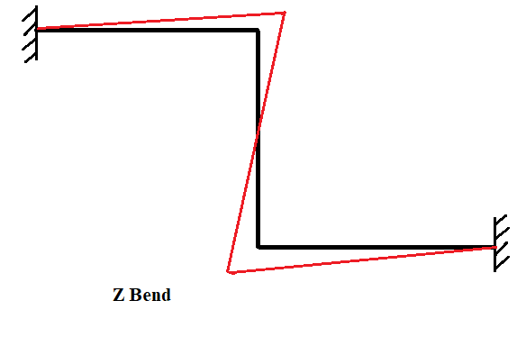
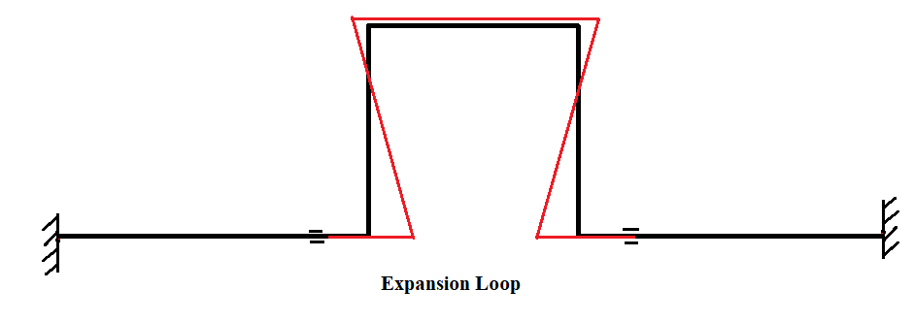
DEFLECTED SHAPES OF VARIOUS EXPANSION STRESSES RELIEVING OPTIONS:
Below are few piping configurations which we discussed earlier to add flexibility. Care must be taken to allow the pipe to move or force it to move as desired. In below the deflected shapes (the way the thermal expansion is absorbed) are shown in red line.

Slide 2
Methods of calculating piping flexibility
As discussed in earlier slides, providing adequate flexibility for absorbing the thermal expansion of the pipe is very much important. However, due to lack of quick method of checking, piping are often laid-out to be either too stiff or too flexible. In either case, valuable time and material are wasted. Here we discuss about some of the quick methods for checking piping flexibility. These methods include
Visual check/ Accepting designs based on experience
Manual methods( Available in QMS spread sheet PEC-EN-VSS-L-15634)
Using basic engineering formulae (Guided Cantilever method)
Using Charts and graphs (Nomographs)
By use of tools like Pipe data pro (Pipe data pro on back end uses guided cantilever method)
Computer based checking ( By using beam element software like Caesar II , Auto-pipe, etc.).

Slide 3
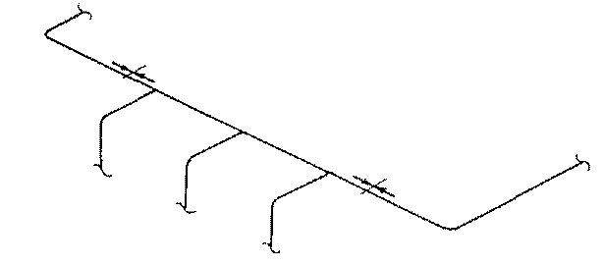
Visual check/ Accepting designs based on experience
The visual check is the first important examination on anything we do. If the design looks strange, then most likely something is wrong with it . By now we at least know that we can not run a piping straight from one point to another. This also applies to the situation when there are two or more-line stops installed at a straight header as shown in Figure below. The line stop or axial stop acts directly against the expansion of the pipe. When two axial stops installed on the same straight leg , the thermal expansion of the pipe located between the stops has no place to relieve.

Slide 4
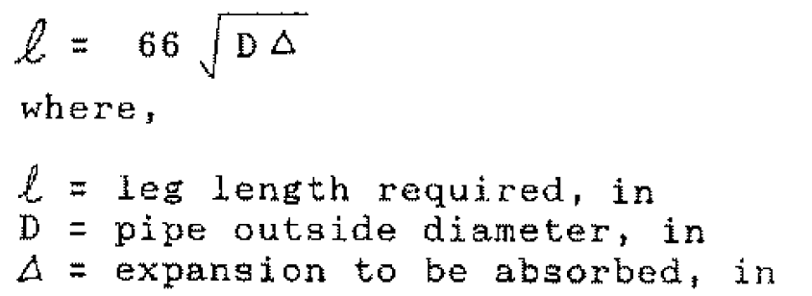

The visual check of the piping flexibility is to look for the pipe legs located in the direction perpendicular to the line connecting the two anchor or other restraint points. The length of the leg is the direct measure of the flexibility. Therefore, the key is to locate the availability of the perpendicular leg and to determine if the length of the leg is sufficient. The required leg length can be estimated by the rule of thumb equation below derived by the guided cantilever approach , for steel pipes.
To use the above equation, the expansion rate of pipe to be known. Below table gives expansion rates of carbon and stainless-steel pipes at several operating temperatures. For intermediate temperatures, the values shall be interpolated. It should be noted that an expansion loop is considered as two legs with each leg absorbs one half of the total expansion.

Slide 5
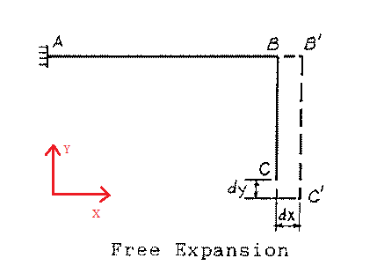
HAND CALCULATIONS
Guided Cantilever method
There are several simplified calculations can be performed quickly with hand. The most popular one is the so-called guided cantilever approach. The method can be explained using the L-bend given in Figure below as an example. When the system is not constrained the points B and C will move to B' and C' respectively due to thermal expansion. The end point C moves dx and dy respectively in X- and Y- directions, but no internal force or stress will be generated.

Slide 6
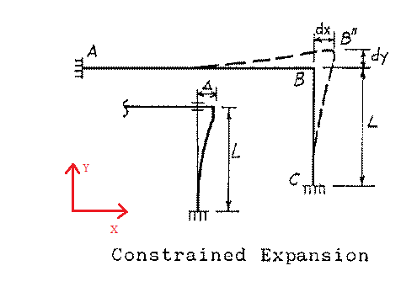
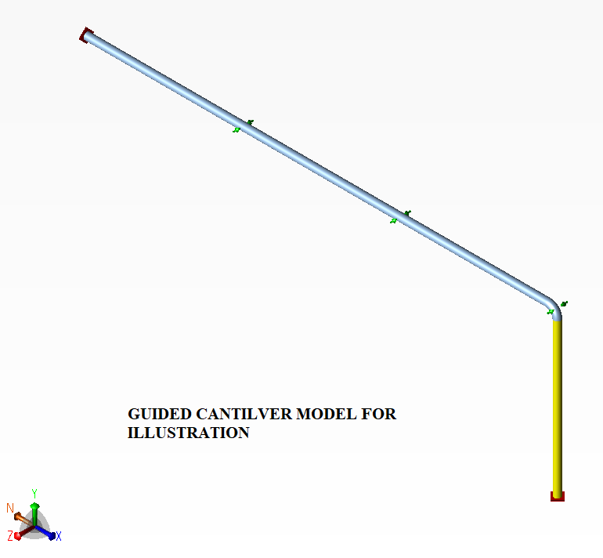
However, in the actual case the ends of the piping are always constrained as shown in Figure below. This is equivalent in moving the free expanded end C' back to the original point C forcing the point B to move to B". The dx is the expansion from leg AB, and dy from leg CB. The deformation of each leg can be assumed to follow the guided cantilever shape (as shown in Caesar II snap below). This is conservative because the end rotation is ignored. The force and stress of each leg can now be estimated by the guided cantilever formula. The leg AB is a guided cantilever subject to dy displacement and leg CB a guided cantilever subject to dx displacement, respectively.

Slide 7
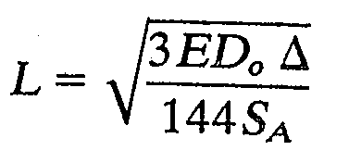
The formulae for calculation of length of perpendicular leg based on the Guided Cantilever Method as per "Introduction to Piping Stress Analysis" by Sam Kannappan is as follows
Where,
Δ = permissible deflection, in
S_{A} = Allowable stress range, psi (equ.1a from 31.3 refer next slide)
L = Length of leg needed to absorb expansion, ft
D_{o} = Outside diameter of pipe, in
E=Modulus of Elasticity at Design Temp., psi
The above equation can be approximated for Carbon/stainless steel as,
L=66 (D∆)^{1/2} in. (same is already discussed in Visual check slide)
The limitations of guided cantilever method are:
The system has only two terminal points and it is composed of straight legs of a pipe with uniform size and thickness and square corner intersections.
All legs are parallel to the coordinate axes.
Thermal expansion is absorbed only by legs in a perpendicular direction.
The amount of thermal expansion that a given leg can absorb is inversely proportional to its stiffness. Because the legs are of identical cross section, their stiffness will vary according to the inverse value of the cube of their lengths.
In accommodating thermal expansion, the legs act as guided cantilevers, that is, they are subjected to bending under end displacements; however, no end rotation is permitted, as shown in Figure before.

Slide 8
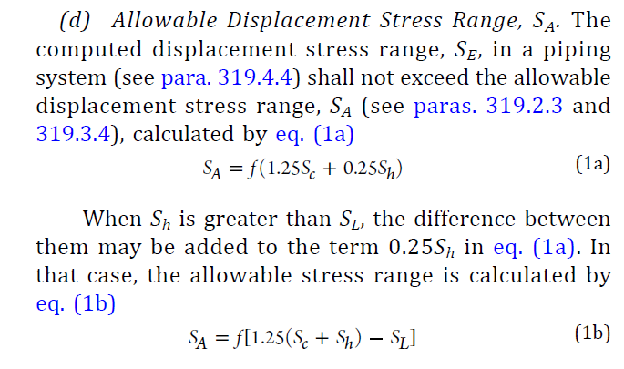
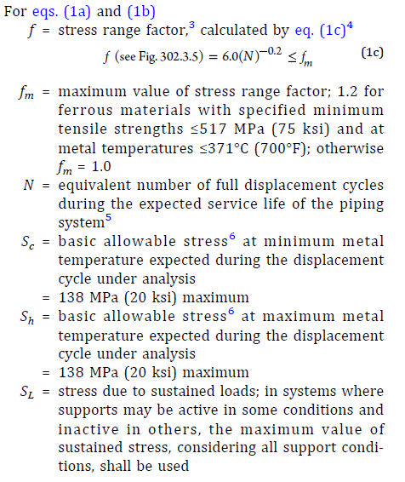
In the equation thermal expansion stress “S” is nothing but SA ,
Formula for SA from 31.3 (without Liberal) to be used.

Slide 9
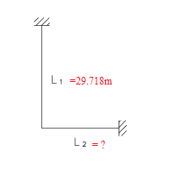
Example:
Let us take an example of 16” Pipe with design temperature 262.8 Deg C and L1 length 29.718m and material A106Gr.B. To find required L2 length procedure using guided cantilever as follows
Solution:
D_{o} = Outside diameter of pipe, in =16”
E=Modulus of Elasticity at Design Temp., psi (from table C-6 of 31.3)
= 188020 Mpa = 2.727e+007 psi
Δ = permissible deflection, in
Δ =α x L1
α=Linear Thermal Expansion, mm/m (from table C-1M of 31.3) = 3.2mm/m
Δ =3.2*29.718= 95.0976mm =3.74399 in
S_{A} = Allowable stress range, psi (equ.1a from 31.3)
S_{A}=f(1.25Sc+0.25Sh)= 1*(1.25*138+0.25*130)=205MPa= 29732.7psi
(f=1 assuming 7000 cycles and Sc and Sh taken from table A-1 of B31.3)
L = Length of leg needed to absorb expansion, ft =?
Now substituting all these in equation
We get L =L2= 33.83 ft =10.3m
By using approximated equation for Carbon/stainless steel L=66 (D∆)^{1/2} in
L =L2= 510.82 in =12.98m

Slide 10
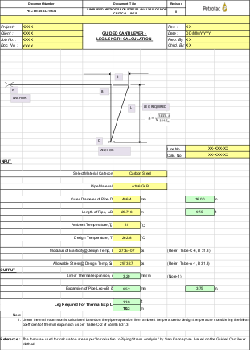

Hand calculation done in previous slide is available as QMS spread sheet.
Refer sheet 2.0 calculation of PEC-EN-VSS-L-15634
For Spreadsheet Click below

Slide 11
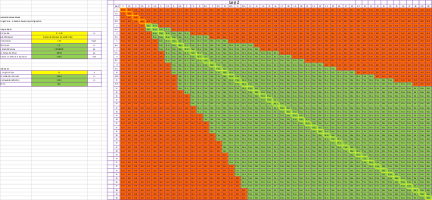

BY USING Guided cantilever simplified sheet
Step-By-Step Procedure:
Enter data in Yellow cells. ( Pipe size, Material and Temperature )
The Leg matrix gets updated and shows Pass/ Fail against each leg combination.
The diagonal rows in the matrix are equal legs
To check an unequal leg is suitable, locate it horizontally and identify the green acceptable second leg band
This sheet helps to you optimize and save time.
For Spreadsheet Click below

Slide 12
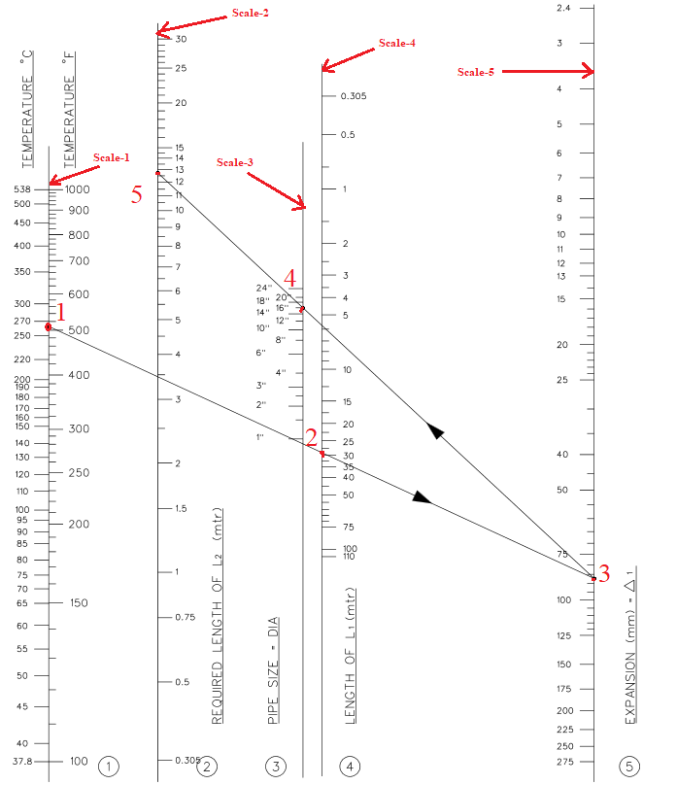
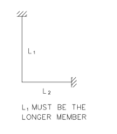
HAND CALCULATIONS
NOMOGRAPHS
A nomograph is a two-dimensional diagram designed to allow the approximate graphical computation of a mathematical function. Below nomograph is used to calculate length of perpendicular leg required to compensate/ absorb expansion.
Scale-1 ➔ Design Temp.
Scale-2 ➔ Length of perpendicular
leg required to compensate
expansion of L1 Pipe leg
Scale-3 ➔ Pipe Size
Scale-4 ➔ Length of L1 Pipe leg
Scale-5 ➔ Thermal Expansion

